Slide 1
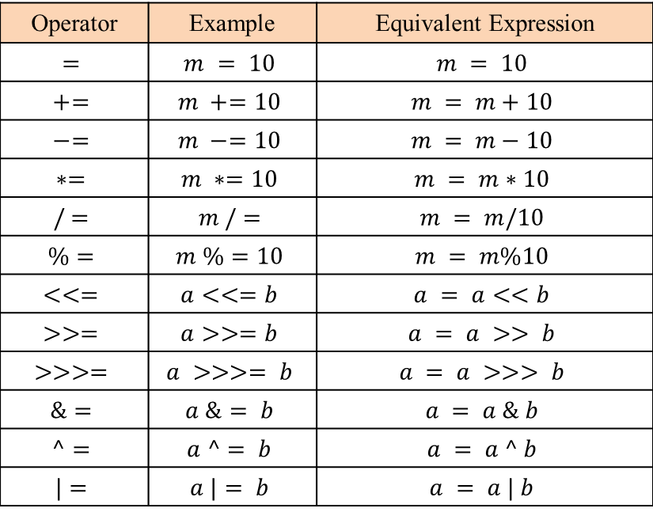
Assignment Operators
Operator | Example | Equivalent Expression
$$=$$ | $$m = 10$$ | $$m = 10$$
$$+=$$ | $$m +=10$$ | $$m = m+10$$
$$−=$$ | $$m −=10$$ | $$m = m−10$$
$$∗=$$ | $$m ∗=10$$ | $$m = m∗10$$
$$/ =$$ | $$m / =$$ | $$m = m/10$$
$$\%=$$ | $$m \%=10$$ | $$m = m\%10$$
$$<<=$$ | $$a<<=b$$ | $$a = a<<b$$
$$>>=$$ | $$a>>=b$$ | $$a = a >> b$$
$$>>>=$$ | $$a >>>= b$$ | $$a = a >>> b$$
$$\&=$$ | $$a \&= b$$ | $$a = a \& b$$
$$^=$$ | $$a ^= b$$ | $$a = a ^ b$$
$$|=$$ | $$a |= b$$ | $$a = a | b$$

